Slide 1
DEEPFAKE DETECTION USING MACHINE LEARNING
PRESENT BY SUPERVISOR
RAJESH .A Mrs. S. SARANYA M.E.,
SIVASURIYAN .M ASSISTANT PROFESSOR;
ILAVARASAN .R DEPARTMENT OF
SURYA . S INFORMATION TECHNOLOGY

Slide 2
OBJECTIVE
This project aims to develop a deepfake detection model using a Convolutional Neural Network (CNN).
However, we explore a semi-supervised learning approach (ResNetV1 + MTCNN) on a subset of the DeepFake Detection Challenge dataset due to its size.
Our goal is to demonstrate that this alternative approach can outperform a standard CNN.

Slide 3
ABSTRACT
Deepfake detection is a technique used to identify manipulated media, like images or videos, that have been altered using machine learning algorithms.
It works by analyzing for inconsistencies in facial movements, body movements, and other visual artifacts.
It includes pre-trained models such as MTCNN (Multi-Task Cascaded Convolutional Neural Networks) for face detection and alignment, and InceptionResnetV1 for detecting whether an image is fake or real.

Slide 4
Problem Statement
This technology has the potential to create convincing fake videos, images, and audio recordings that can be used to deceive people and spread misinformation on a large scale.
This has already resulted in political and social chaos, and the problem is expected to worsen in the future.
Therefore, there is a need for the best solution that can detect and prevent deep fakes from spreading.
This project aims to address this problem by developing a convolutional neural network using transfer learning with ResNetV2, a pre-trained model that can detect deep fakes with an accuracy of 94%.

Slide 5
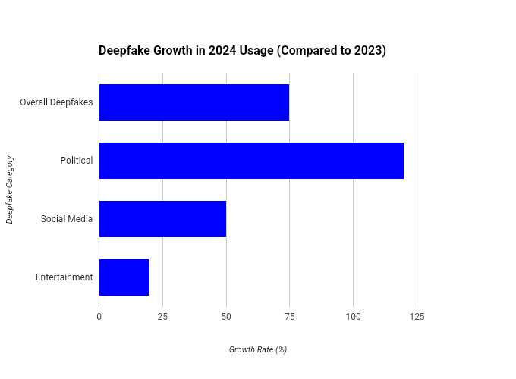

Slide 6
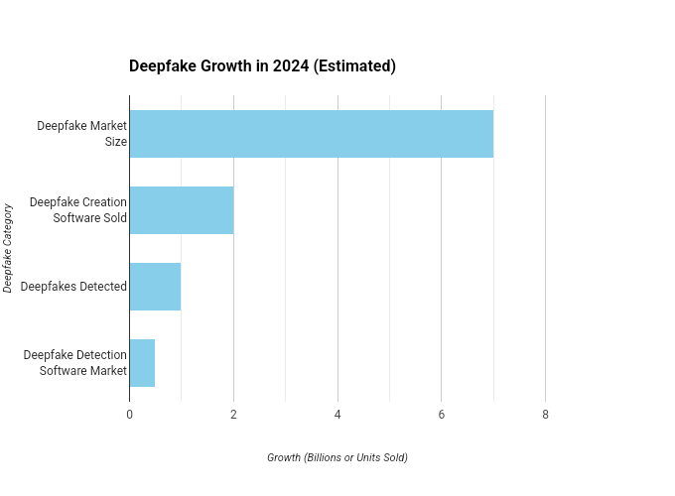

Slide 7
INTRODUCTION
With the technology becoming accessible to any user, lots of deepfake videos have been spread through social media.
Deepfakes are AI-generated videos (sometimes audio) that realistically replace a person with someone else.
There are many instances where DF is spread over social media platforms causing spamming and providing wrong information.
Such DFs are terrible and can lead to people's being threatened by, or misled by, them.

Slide 8
EXISTING SYSTEM
It's important to note that deepfake detection is an ongoing area of research. No system is perfect, and misidentification errors can occur.
While existing systems achieve good accuracy, deepfake creators are constantly developing new techniques.
The goal is to stay ahead of this evolving threat by continually improving detection methods.

Slide 9
DISADVANTAGES
Technical limitations: It's important to acknowledge the potential downsides and challenges.
Evolving technology: Deepfake creators constantly improve their techniques, making it an ongoing arms race for detection systems. Keeping up requires continuous adaptation and resource investment.
Accessibility and cost: Advanced detection tools might be expensive or require specialized hardware, potentially limiting their widespread and accessible use.

Slide 10
PROPOSED SYSTEM
Accurate face detection: MTCNN excels at accurately detecting faces in images and videos, even under challenging conditions like low lighting, occlusion, or variations in pose. This is crucial for deepfake detection, as accurately pinpointing the manipulated region is essential.
Efficiency: MTCNN is relatively lightweight and computationally efficient compared to other face detection models. This is important for real-time applications where fast processing is needed.
Pre-trained models: Inception Resnetv1 comes with pre-trained models on large datasets like VGGFace2 and CASIA-Webface, providing a strong starting point for fine-tuning on specific deepfake detection tasks.
Flexibility: The model can be adapted for various tasks beyond facial recognition, like anomaly detection and image classification, offering potential for broader applications in deepfake analysis.

Slide 11
ADVANTAGES
End-to-end pipeline: By combining MTCNN for face detection and Inception Resnetv1 for feature extraction, you create a complete deepfake detection pipeline.
Complementary expertise: MTCNN focuses on the "where" (finding faces), while Inception Resnetv1 focuses on the "what" (analyzing facial features). Together, they provide a comprehensive approach to detection.
Community support: Both MTCNN and Inception Resnetv1 have active communities with ongoing research and development, ensuring access to updates and improvements.
Overall, MTCNN and Inception Resnetv1 offer a valuable combination for building robust deepfake detection systems.

Slide 12
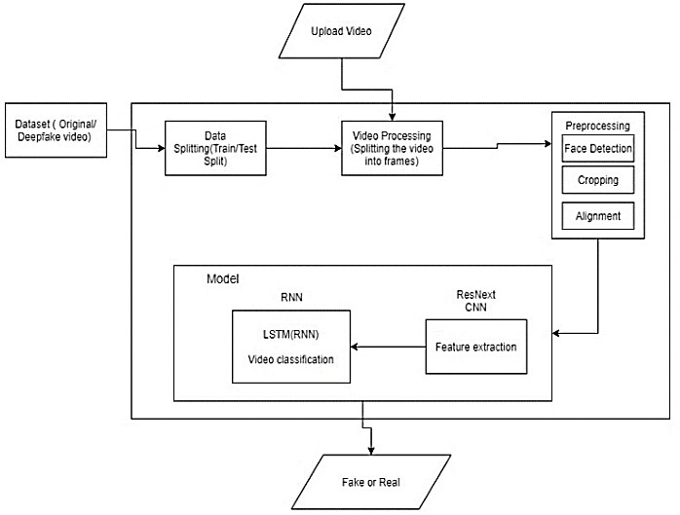
System Architecture

Slide 13
Module List
Input
Pre-processing
Face Detection
Face Extraction
Deepfake Classification
Decision Making
Output

Slide 14
Module Description
1) Input
The system takes a video or image as input.
2) Pre-processing
- The video/image is split into individual frames.
- Each frame is resized to a standard size suitable for the ResNetV1 model.
3) Face Detection
- An MTCNN (Multi-task Cascaded Convolutional Networks) model is used to identify and localize faces within each frame.
- MTCNN outputs bounding boxes around the detected faces.

Slide 15
4) Face Extraction
- Based on the bounding boxes from MTCNN, the facial regions are cropped from each frame.
5) Deepfake Classification
- The cropped faces are fed into a pre-trained ResNetV1 model (a convolutional neural network).
- ResNetV1 analyzes the facial features to determine the likelihood of it being a deepfake.
- The model outputs a probability score for each face, indicating the confidence of it being real or a deepfake.

Slide 16
6) Decision Making
- A threshold is set.
- If the probability score from ResNetV1 is higher than the threshold for a frame, it's classified as a deepfake.
- If the score falls below the threshold, it's classified as real.
7) Output
- The system outputs a final classification for the entire video/image (deepfake or real) based on the individual frame classifications and potentially using aggregation techniques .

Slide 17
REQUIREMENTS
Hardware Requirements
Processor : Intel i5 9th gen or AMD Ryzen 5
RAM : 8 GB
SSD : 160 GB
GPU : NVIDIA GeForce GTX 1650 (4 GB)

Slide 18
REQUIREMENTS
Software Requirements
Operating system : Windows OS
Front End : Gradio
Back End : Gradio
IDE : Jupyter Notebook

Slide 19
CONCLUSION
The main goal of this research project was to develop a system that could accurately anticipate a deepfake image. With the help of this initiative, users will be able to recognise deep-fake photos and protect themselves from falling for false information on online sites.

Slide 20
FUTURE WORK
Our project can be extended in the following ways:
● The following model can be extended to detect artificial audio and then be combined with an image processing module.
● Various other transfer learning models can be used to increase accuracy and to be able to classify the data correctly.
● It is observed that low-quality images and images of larger size are giving predictions with lower accuracy; this can be rectified by training the models with more epochs for better accuracy.

Slide 21
REFERENCES
[1] Joshua Brockschmidt, Jiacheng Shang, and Jie Wu. On the Generality of Facial Forgery Detection. In 2019 IEEE 16th International Conference on Mobile Ad Hoc and Sensor Systems Workshops (MASSW), pages 43–47. IEEE, 2019.
[2] Yuezun Li, Ming-Ching Chang, and Siwei Lyu. In Ictu Oculi: Exposing AI Generated Fake Face Videos by Detecting Eye Blinking. arXiv preprint arXiv:1806.02877v2, 2018.
[3] TackHyun Jung, SangWon Kim, and KeeCheon Kim. Deep-Vision: Deepfakes Detection Using Human Eye Blinking Pattern. IEEE Access, 8:83144–83154, 2020.
[4] Konstantinos Vougioukas, Stavros Petridis, and Maja Pantic. Realistic Speech-Driven Facial Animation with GANs. International Journal of Computer Vision, 128:1398–1413, 2020.
[5] Hai X. Pham, Yuting Wang, and Vladimir Pavlovic. Generative Adversarial Talking Head: Bringing Portraits to Life with a Weakly Supervised Neural Network. arXiv preprint arXiv:1803.07716, 2018.

Slide 22
THANK YOU

